Slide 1
Hashing Data Structure

Slide 2
Introduction
1.

Slide 3
Introduction
Suppose we want to design a system for storing employee records keyed using phone numbers. And we want following queries to be performed efficiently:
Insert a phone number and corresponding information
Search a phone number and fetch the information
Delete a phone number and related information

Slide 4
Introduction
We can think of using the following data structures to maintain information about different phone numbers:
Array of phone numbers and records
Linked List of phone numbers and records
Balanced binary search tree with phone numbers as keys
Direct Access Table

Slide 5
Introduction
For arrays and linked lists, we need to search in a linear fashion, which can be costly in practice. If we use arrays and keep the data sorted, then a phone number can be searched in O(Logn) time using Binary Search, but insert and delete operations become costly as we have to maintain sorted order.

Slide 6
Introduction
With balanced binary search tree, we get moderate search, insert and delete times. All of these operations can be guaranteed to be in O(Logn) time.

Slide 7
Solution

Slide 8
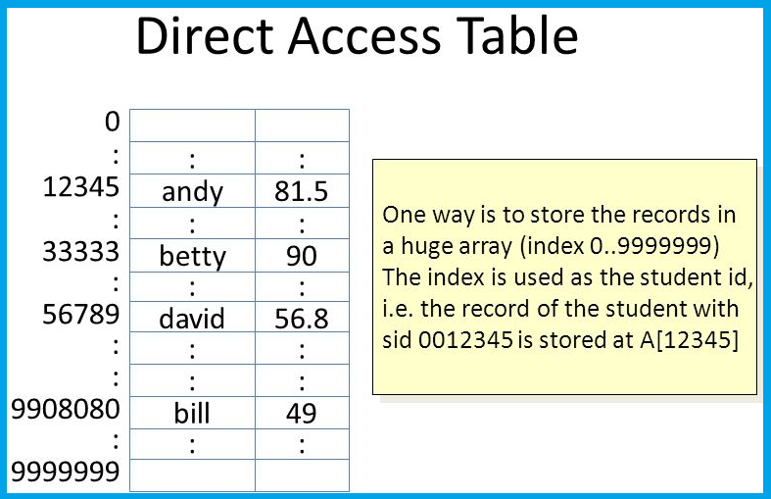
Introduction
Another solution that one can think of is to use a direct access table where we make a big array and use phone numbers as index in the array.

Slide 9
Introduction
An entry in array is NIL if phone number is not present, else the array entry stores pointer to records corresponding to phone number
Time complexity wise this solution is the best among all, we can do all operations in O(1) time. V
extra space required is huge. For example if phone number is n digits, we need O(m * 10^{n}) space for table where m is size of a pointer to record. X

Slide 10
Introduction
Due to above limitations Direct Access Table cannot always be used. Hashing is the solution that can be used in almost all such situations and performs extremely well compared to above data structures like Array, Linked List, Balanced BST in practice. With hashing we get O(1) search time on average (under reasonable assumptions) and O(n) in worst case.

Slide 11
Hashing is an improvement over Direct Access Table. The idea is to use hash function that converts a given phone number or any other key to a smaller number and uses the small number as index in a table called hash table.

Slide 12
Introduction
Hash Function: A hash function maps a big number or string to a small integer that can be used as index in hash table.
A good hash function should have following properties:
Efficiently computable
Should uniformly distribute the keys (Each table position equally likely for each key)
When two keys hash to the same index a collision occurs
Keys are not in any particular order (numerc, alphabetical etc)

Slide 13
Introduction
Hash Table: An array that stores pointers to records corresponding to a given index (phone number). An entry in hash table is NIL if no existing input value (phone number) has hash function value equal to the index for the entry.

Slide 14
Introduction
Collision Handling: Since a hash function gets us a small number for a big key, there is possibility that two keys result in same value. The situation where a newly inserted key maps to an already occupied slot in hash table is called collision:
Chaining: The idea is to make each cell of hash table point to a linked list of records that have same hash function value. Chaining is simple, but requires additional memory outside the table.
Open Addressing: In open addressing, all elements are stored in the hash table itself. Each table entry contains either a record or NIL. When searching for an element, we one by one examine table slots until the desired element is found or it is clear that the element is not in the table.

Slide 15
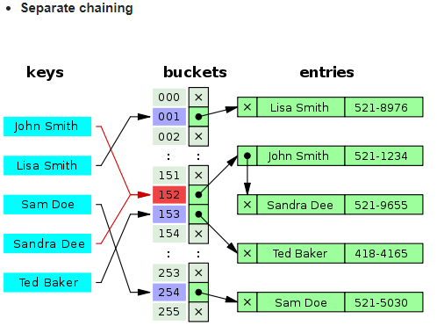
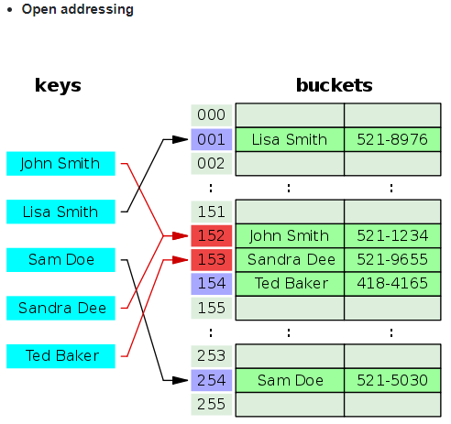
Introduction

